Slide 1
Strategizing for Ecological Management & Implementing a Soil Health Management System
Soil Health Division

Slide 2
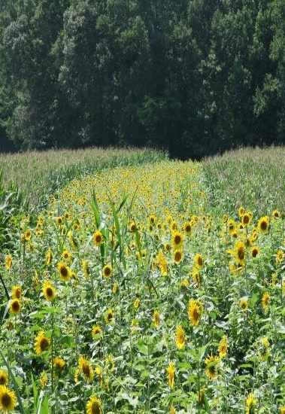
Objectives
Identify key components of practices and activities to develop a Soil Health Management System
Describe the interaction, dependency and synergy between practices in a SHMS
Recognize barriers to implementation
Describe an entry level strategy to develop a SHMS

Slide 3
Soil Health Management System
Collection of NRCS and other conservation practices, BMPs, activities, that focus on maintaining or enhancing soil health
Address all the soil health principles
Create a “synergistic” effect
Cropping system and landuse specific
Notes:
A collection of NRCS conservation practices that focus on maintaining or enhancing soil health by addressing the four soil health planning principles: minimize disturbance, maximize soil cover, maximize biodiversity and maximize presence of living roots. SHMS are cropping system specific and contain practices that treat the entire field and when applied as a system achieve the greatest impact on soil health by creating a synergistic effect. Information obtained through soil health assessments can be used in developing a SHMS targeting specific constraints that have been identified.

Slide 4
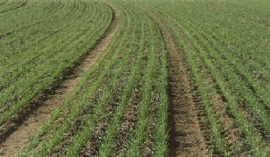
Best Accepted New Technology
Conservation activities that might not be in an NRCS conservation practice standard. Examples:
  Companion cropping
  Traffic management
  Precision application of nutrients and pesticides
  Use of floatation tires or tracks
  Bale Grazing
Notes:
** add examples relevant to your region: Relay cropping, Green Manure, full season cover crops that are grazed as standing forage after senescence.
These are activities that benefit soil health but may not fall under an NRCS conservation practice standard
Allows for the use of innovative ideas
As equipment and grain carts are getting bigger, the weight is exponentially larger, so use of flotation of tires will spread the weight more easily causing less compaction

Slide 5
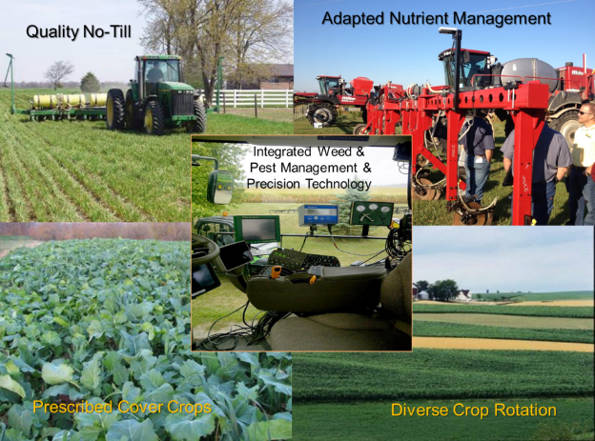
Soil Health Management System
Achieving soil health through:
  A Quality No-till/ Strip-till System
  Diverse and Strategic Cover Crops
  Adapted Nutrient Management
  Integrated Weed & Pest Management
  Diverse Crop Rotations
  Precision Farming Technology that results in reductions overall
  Prescriptive Buffers
  Livestock integration
Soil Health is not a destination...it’s a Journey
Notes:
** Substitute practices most relevant to your region.
“Soil health” is a journey that’s obtained by implementing a system of management practices that are often planned above and beyond the minimums in our standards.
It’s the implementation of a suite of conservation practices to a high-level/criteria, that leads to soil health and increased SOM and the subsequent treatment of Resource Concerns (RCs). Many RCs are linked to SH indicators (compaction, infiltration, water-holding capacity, nutrient cycling, biodiversity, etc.) and the resulting water quality, air quality, wildlife habitat, etc. benefits.
Discuss difference between minimum and high-level criteria

Slide 6
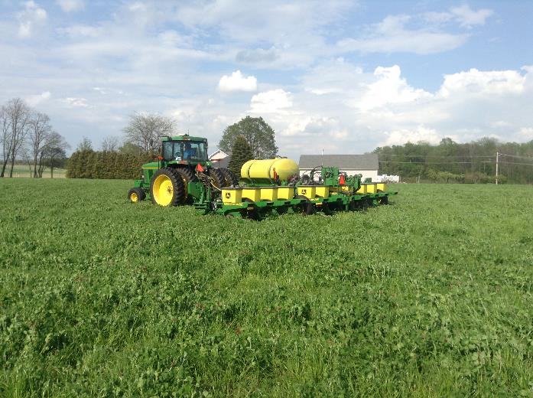
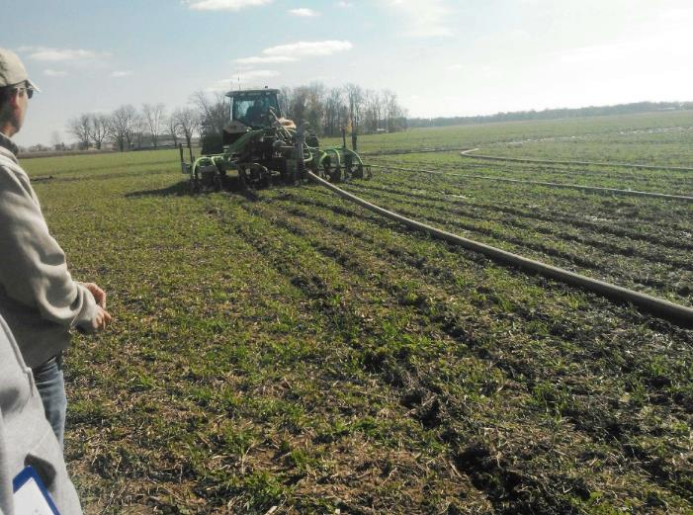
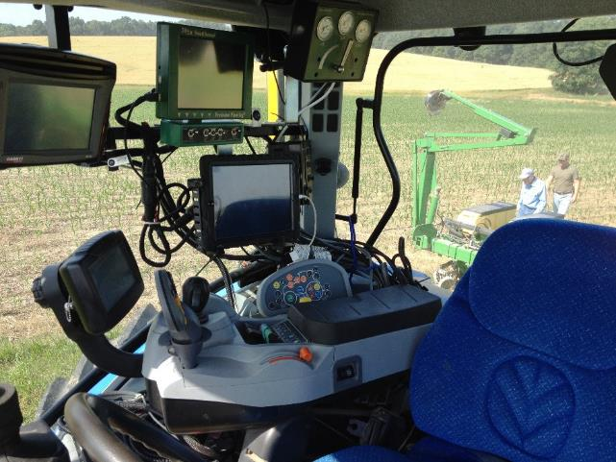
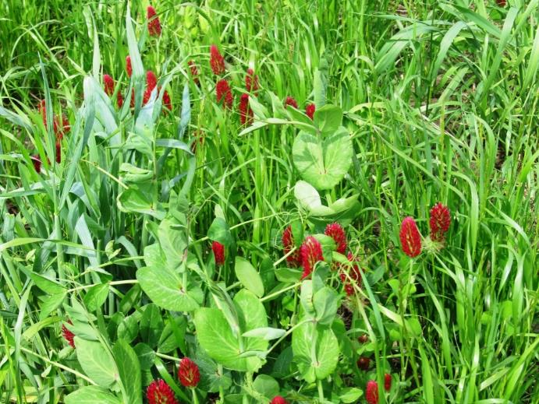
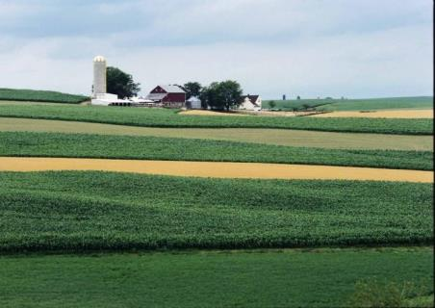

Adapted nutrient management
Quality no-till/strip-till
New technology
and
integrated weed &
pest management
We can package a system of practices that Improve Soil Health!
Prescribed cover crops
Diverse crop rotation
Notes:
These photos need to be localized to local conditions, they will need to be the same ones used on slide 10, 19, 26, and 28
**substitute pictures of relevant practices for you region.
Improving soil function is about optimizing and understanding all aspects of the conservation cropping system such that soil health is the central focus with every operation. Each practice should complement and enhance the others of the system.
Think of a Soil Health Management System as a collaboration of practices that have synergy. Have an in depth class discussion on the difference between each single practice and how to integrate them into a SH system.
Quality No-till vs No-till…Adapted Nutrient Management vs Nutrient Management and so on for each.

Slide 7
Adapted nutrient management
Quality no-till/strip-till
New Technology and integrated Weed & pest management
We can package a system of practices that Improve Soil Health!
Prescribed cover crops
Diverse crop rotation
Notes:
This is highlighting notill :
This photo can be adapted to localize conditions
So lets discuss what we mean by-Quality No-till vs No-till…You may have heard several negative references to no-till (ask the class for examples). In many cases, poor results stem from mismanagement or a lack of understanding of changes needed in equipment, nutrient management or pest management. Lets review and discuss a few of the key points (many of which we may have discussed this week)

Slide 8
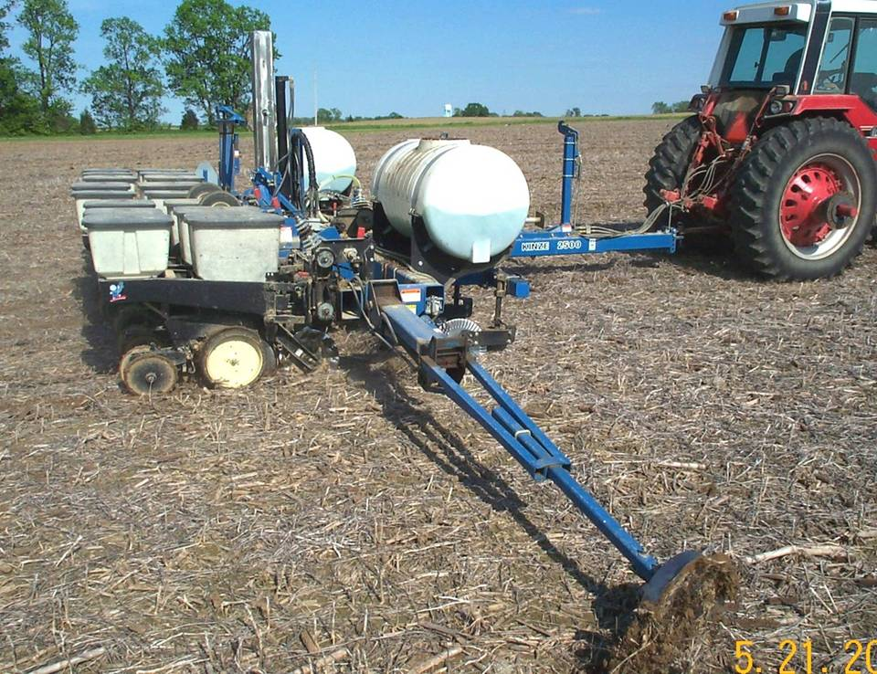
No-Till / Strip-Till
Planter set-up and maintenance is critical
Notes:
Quality No-Till goes beyond the minimum criteria in the practice standard
Definition: “Limiting soil disturbance to manage the amount, orientation and distribution of crop and plant residue on the soil surface year round”
Criteria: no burning of residue, uniformly distributed, no full-width tillage, etc.
Need to include Planter set up to obtain near perfect stands.
Unfortunately, few planters are tuned to the level of perfection which is needed to achieve these capabilities.
One of the best times to go through a planter is in the summer when a post emergence stand evaluation, or ear count diagnosis has been made. By waiting until late winter, farmers run the risk that parts are on back order.

Slide 9
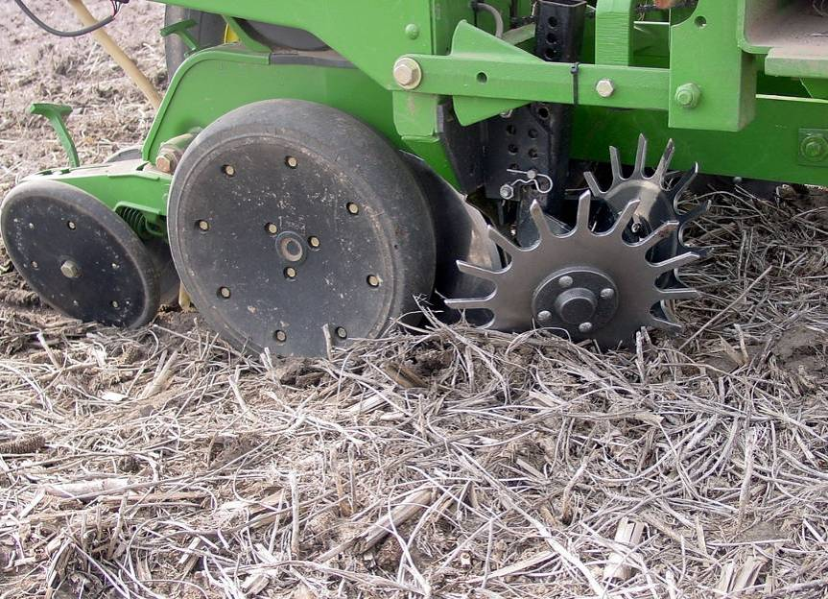
Goal: Every seed at the exact same depth…
Notes:
No matter the system the goals are the same…every seed emerging the same day. To accomplish this, every seed needs to be placed at the same depth, at the same spacing and in the same environment. Discuss what uneven emergence does to yield potential in crops like corn. Discuss how the temp & moisture are more different at different depths in no-till than in a full width tillage system, thus the importance of depth is greater.

Slide 10
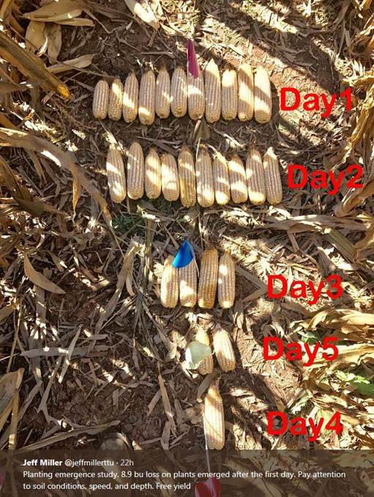
Notes:
READ NOTES CAREFULLY!!!!
This slide is of a yield study showing an 8.9 bu yield loss due to uneven emergence, each day shows a change in corn ear sized the day represents each day of emergence. So on all the corn plants should have emerged together on day one, however they emerged over 4 days with delayed emergence due to planter issues. PAY ATTENTION TO SOIL CONDITIONS, SPEED AND DEPTH.
If every seed can’t get planted on the same depth its going to emerge at different rates and that means changes in yield. So we don’t want to be ok with “well it was not that great a stand but I guess that’ what we have to live with it,” that’s not ok. We have technology available today that we absolutely can have every seed emerge the same day to optimize yield from esp. corn. That’s an example of a few key items in the previous slides that can make or break the difference between quality notill or just notill. When I hear the word notill we don’t’ want to hear them talk about notill just being a thing. It is a very intricate system that we have management and technology capability available to make notill function in any environment.

Slide 11
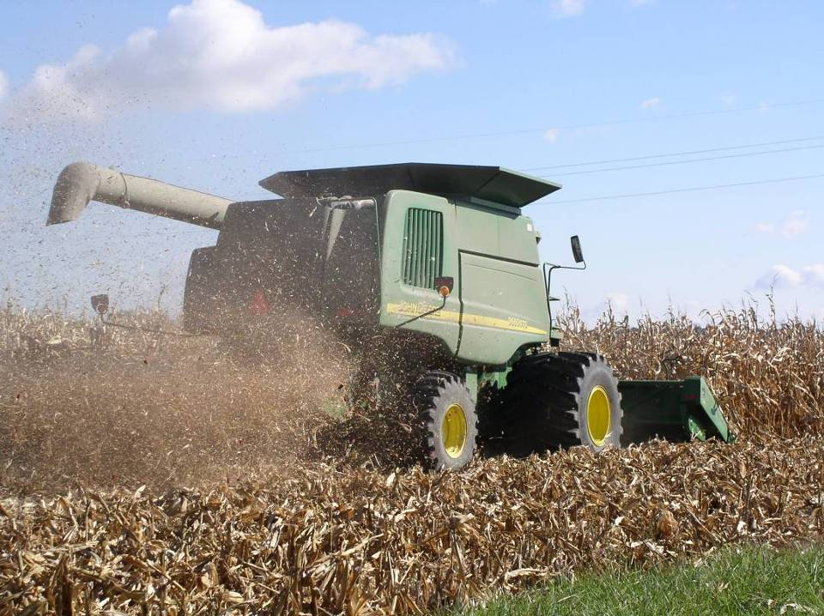
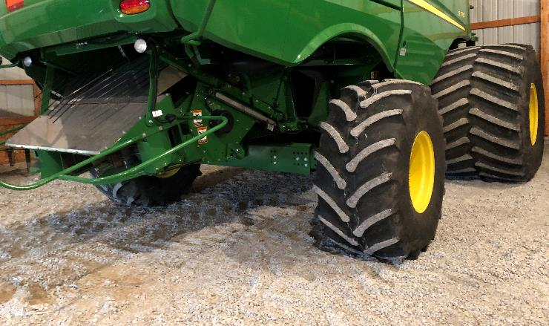
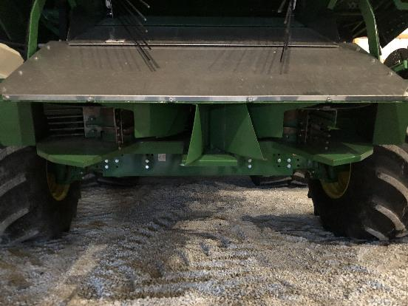
Spread the Weight!
Spread residue
Notes:
Need to carry the weight of growing equipment more wisely and spread the volumes of crop residues evenly, especially with the tendency toward wider (40’+) grain platforms.
Windrowing of residue, especially low biomass crops like soybean can cause problems later
Ask students about problem/observations they’ve made with no-till in their work areas.

Slide 12
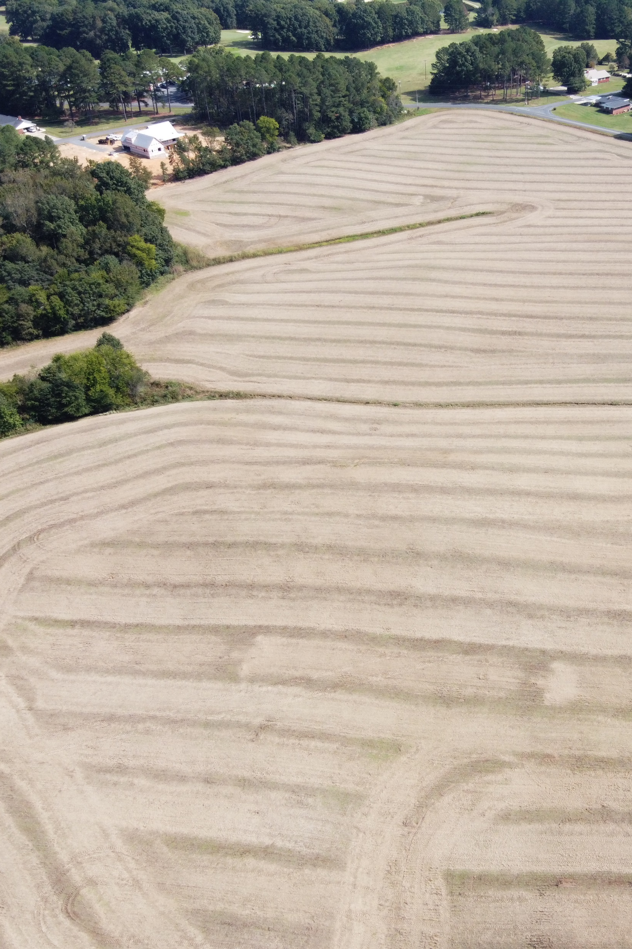
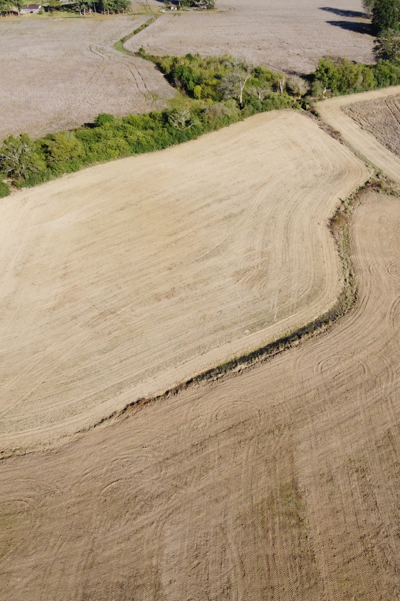
Spread the Residue!
PHOTOS: USDA - SHD
Notes:
Photo right is spread; photo left is windrowed or not spread see below for explanation of why!
Combine Equipment For Crop Residue Chopping And Spreading
Nowadays, combine harvesters have wider headers and grain platforms and concentrate a larger amount of plant material into the same narrow band exiting the combine.
Then, the material has to be spread back onto the wide harvest swath, challenging the residue managing task.
For uniform distribution enhancement, combine harvesters are now equipped with choppers, spreaders, or a combination of both for better residue processing.
In fact, combines with header widths of 20 to 30 feet or more may not be sufficiently equipped to uniformly scatter a large amount of residue.
These cases may call for adding manufacturer options or after-market equipment to achieve intensive residue management.
It is also necessary to modify, check, and maintain existing equipment.
For a better understanding of residue processing, the next section is going to discuss how important combines’ chopping and spreading processes are.
The Importance Of Proper Residue Chopping And Spreading
As mentioned above, the modern combine harvesters release larger volumes of material-other-than-grain (MOG) on a small-width swath compared to the width of the header.
Therefore, the weed and grain loss are concentrated at the back of the combine.
In fact, if the crop residues are left at the rear of the combine and are shallowly incorporated into the soil, the organic material’s accumulation in the upper soil layer turns out to be an issue because of their inadequate decomposition and conversion to humus.
When not gathered, managing the crop residue created from the crop harvesting is really essential for the following seeding process, especially a reduced or no-tillage process.
The soil heavy-harrowing would gather the straw and corn husks in bunches, which may not be well incorporated into the soil.
As a result, if all these residual components are not chopped and evenly spread earlier, they do not incorporate into the soil to deliver useful nutrients by mineralization.
The successful crop residue distribution can improve erosion protection and stand establishment.
It is thought that single-pass harrowing or cultivating of the soil is not as good as no-tillage since weed seeds are assimilated into the soil and loosen the stubble.
As a consequence, the failure of crop residue management inflicts a negative impact on the seeding process efficiency, creating the uneven distribution, hairpinning, plugging, soil aeration lack, and drying and finally, low and uneven germination and the development of the next crop seeds.
In short, uniform distribution has various benefits for farmers in no-till, minimum-till or conventional till systems, consisting of better erosion resistance, less plugging of tillage or seeding devices, and enhanced stand establishment.
Basic Requirements For Combine Harvester’s Residue Chopping And Spreading System
It is evident that the modern combine harvesters are designed with a chopping-spreading system that chops and spreads the straw, chaff, and husks uniformly across the header cutting width.
For excellent performance ensuring, the chopping and spreading system must meet a series of technological and process efficiency requirements, as below:
Deliver consistent and uniform short chop length
Uniformly spread the chopped material over the entire working width of the combine
Produce a relatively low quantity of dust
Use low driving power
Need a low level of maintenance
In fact, material resistance to cutting largely depends on the physical and mechanical properties of MOG, feeding and discharging path of the material, and chopper knife design and kinematics.
The following section will unveil the construction of chopping and spreading systems that are equipped for the combine harvesters.

Slide 13
Knowledge Check: Poll Question
What Issues with No-till have you seen or heard of in your location?
Notes:
Have them document some of the issues on a chart or if in virtual mode in the chat.

Slide 14
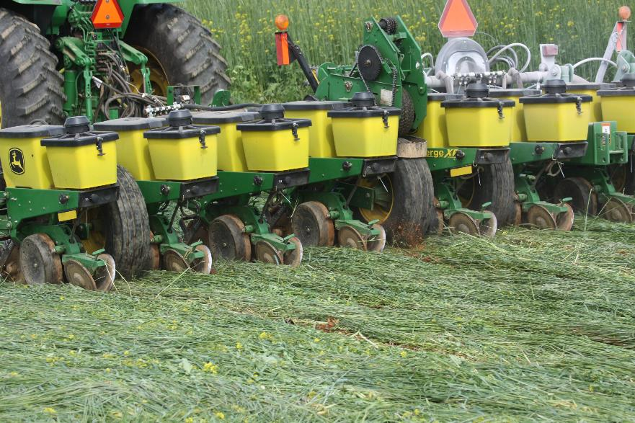
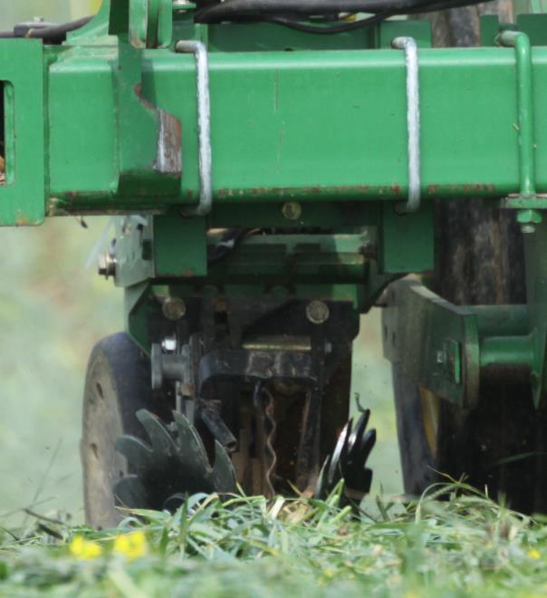
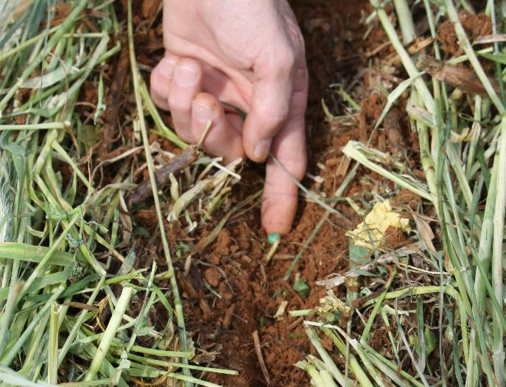
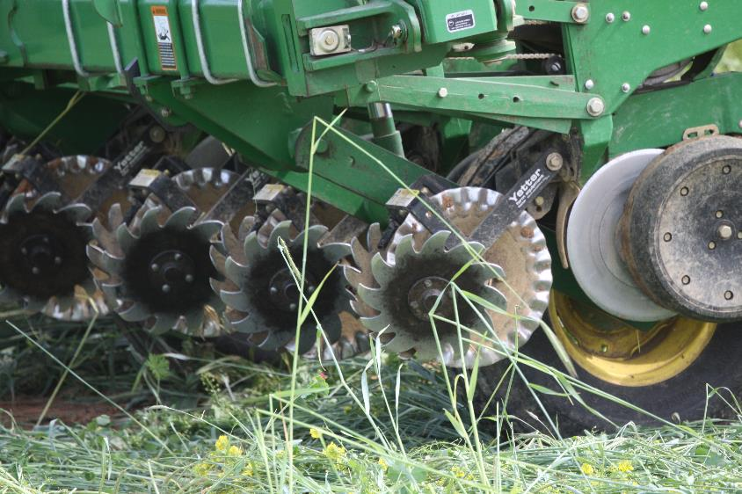
Notes:
**Some of this may have already been covered at the farm or during the Cover crop module-
Planting “green” can be done if timing for termination and planting are synchronized (discuss pros and cons). Waiting several days after terminating can result in residue that won’t cut/slice easily, need to wait 2 weeks or more for the residue to dry down (discuss pros and cons)
Coulters need to be sharp etc.etc.
Planting into heavy residue may require many additional adjustments and/ or add- ons. These are very site and soil specific!
Photos: USDA-NRCS IN

Slide 15
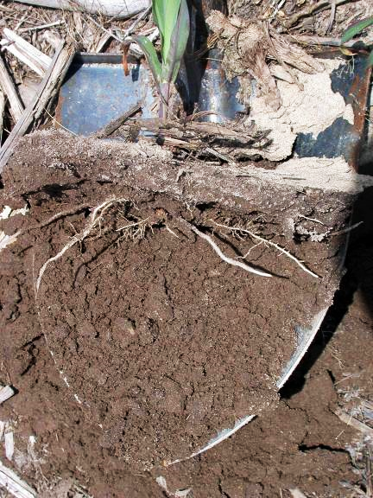
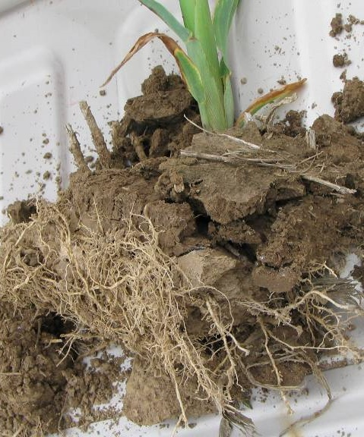
Poor Structure = Yield Loss
Notes:
Poor planter set-up can actually lead to further soil function complication by causing side wall compaction, restricts root growth from moving out in all directions
Photos USDA NRCS IN

Slide 16
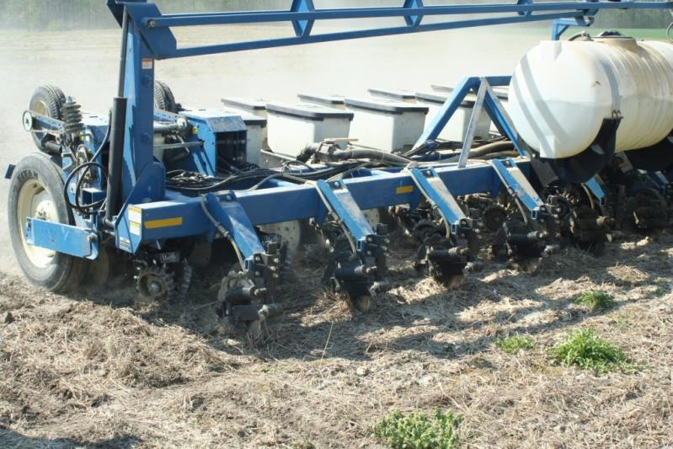
No-Till Planter Attachments
Less total down pressure is needed
RID
Match field conditions on the go!
Notes:
Planters can be designed with precision technology and/or add-ons to reduce side wall compaction.
Less down pressure is needed as soils become healthy,
These are site and soil specific!!!
Photo: USDA NRCS IN

Slide 17
Adapted nutrient management
Quality no-till/strip-till
New technology and integrated weed & pest management
We can package a system of practices that Improve Soil Health!
Prescribed cover crops
Diverse crop rotation
Notes:
Quality Adaptive nutrient management- We must understand that when we stop tilling and/or add cover crops, we significantly change the nutrient cycles and especially the availability of nitrogen

Slide 18
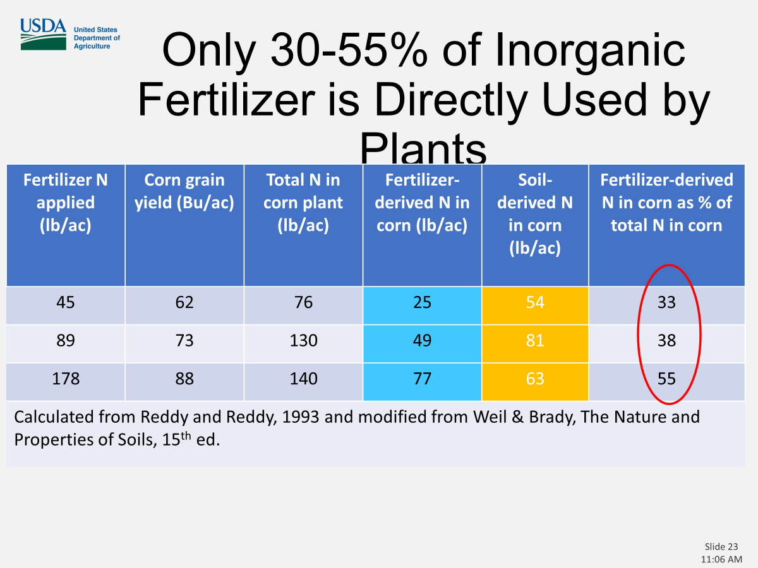
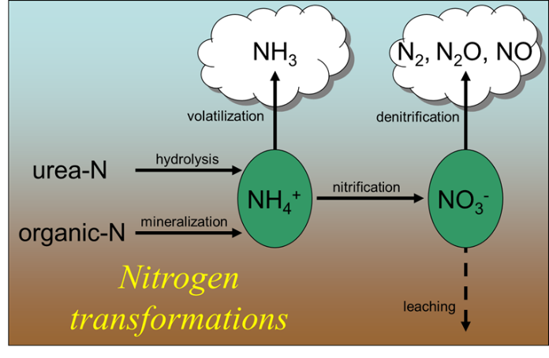
Compounding extent of soil degradation and effect on other cycles
Denitrification:
Anaerobic conditions cause Losses of N₂, NO and N₂O
Leaching
Plenty of heat to convert ammonium to nitrate
Nitrate leaves with the water
Both applied and soil available N are at risk of loss
Notes:
During transition from full width tillage to a soil health system, degraded soil conditions will affect nutrient cycling, and causes additional resource concerns.
Saturated soils caused by compacted soils with poor aggregated stability leads to accelerated denitrification, goes anaerobic
Also accelerates leaching, converting NH3 to NO3 more water soluble, increase leaching
Reddy paper in resources folder

Slide 19
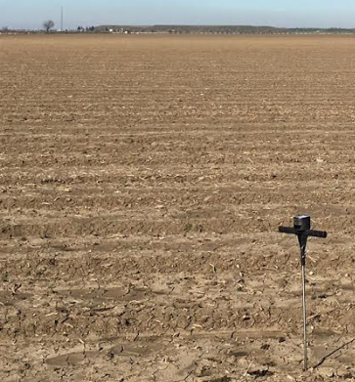
Dominant Nutrient Management Strategy
N gaseous loss
N and P Fertilizer
Plenty N & P are added to meet the yield goal. Soil with excess fertilizers is leaky
Plant and other residues
Fallow land is maintained for 4-8 months, providing limited food for soil life
P
N
Depleting SOM &
Soil life
Less N & P mineralization
Soluble N and P in Soil
P fixation
Perennial system with a bare floor then it is also limiting for soil life
Mineral P reservoirs
P Solubilization
Leaching & runoff
Erosion
Adapted from Drinkwater & Snapp, 2007
Notes:
READ THE DRINKWATER SNAPP Paper first!!!
The dominant nutrient management paradigm is what we do on majority of the croplands. *We apply a lot of nutrients & soil cannot hold excess nutrients thus it become leaky. *Width of the arrow indicate the quantity of fertilizer apply. And fertilizer goes down to the soil solution. *Then part of it taken up by the plant, some N loss to leaching and runoff & *to the air. *A large portion of P fix and *a small portion of mineral P becomes available & some P is loss to erosion. *In this paradigm, little plant residues return to the soil thus depleting SOM, top soil and of course soil biology. *Annual crop land typically fallowed for 4-8 months out of the year. *Perennial system with a bare floor also limiting for soil life.
Some of the nutrients are taken up by the plant & the remaining nutrient lost from the soil because soil does not have the capacity to hold the nutrient. One of the reasons is low SOM (in contrast to the prairies example). Plant & other residues returned to the soil is also going down.
We also look at the potential mineralizable fraction (soil is the main source of N ->50% coming from the soil). Every rotation it is going down. Every year it is going down weaker. It is no more sustainable and we need to focus on regeneration to make soil healthy

Slide 20
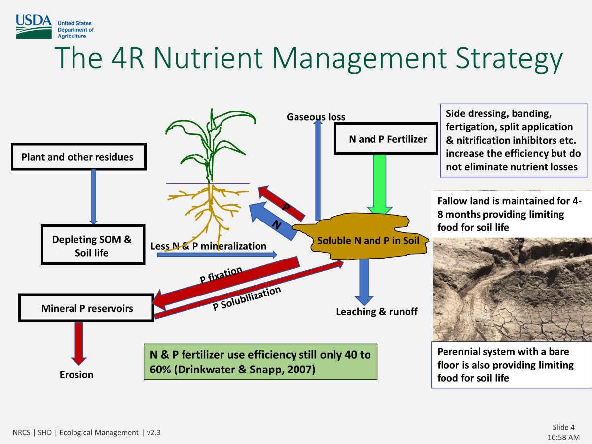
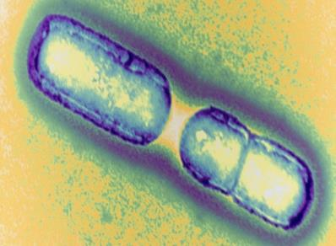
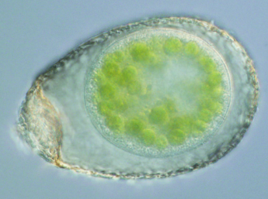
Nitrogen Mineralization and
Immobilization
Biology
Notes:
Most have seen a typical Nitrogen cycle diagram and most think this is just a chemical process. Click to bring in the animation. However, no matter how well you time, place, and adjust rate and source of nutrients, about half of the nutrients a crop takes up will come from the soil. And it is biologically driven. This is only a small part of the process but I think it gives you a basic idea of how life, death and mineralization works in that Rhizosphere.
Everything is made up of differing amounts of carbon and nitrogen. C/N ratios vary between specie but generally Bacteria have a lower C/N ratio than a Protozoa or Nematode.
Bacteria are around 5:1 and a Nematode, which eats the bacteria, is 10:1. A Nematode will need to eat two Bacteria to get 10 units of Carbon but it only needs one of the Nitrogen units, so he excretes the extra into the soil in a form that a plant can very readily take up. That is exactly what we want to happen as long as there is a plant there to take up that Nitrogen.

Slide 21
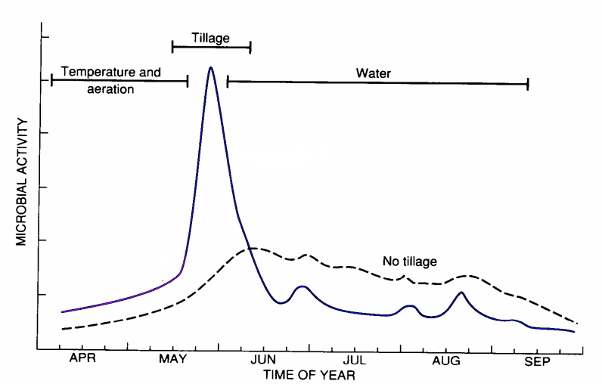
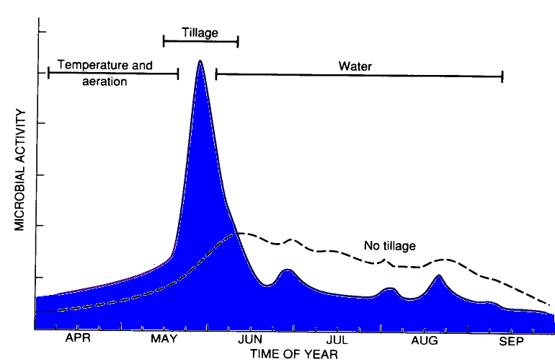
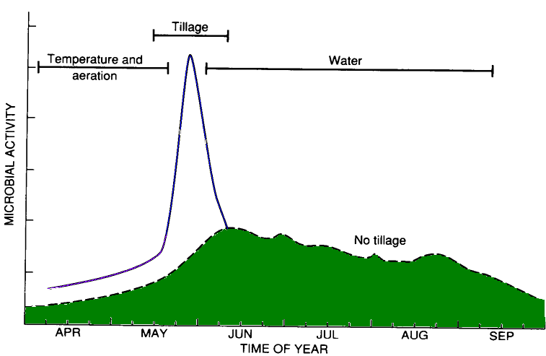
Effect of Tillage on Microbial Activity
The primary factors controlling microbial activity vary with time
+ SOM
Which tillage system has more microbial activity when the crop benefits from the CO₂ ?
Which tillage system has more microbial activity ?
CT
Soil respiration in NoTill (NT) system
NT
Soil respiration in Conventional Tillage (CT) system
Havlin et al. (1999)
Notes:
Tillage accelerates decomposition of crop residue, which releases nutrients earlier in the growing season and most of our crops hybrids have been selected from a full width tillage system that delivers early nutrients. Of course this is at the expense of carbon and it happens before plants need them, so they can be lost through leaching. Discuss how this cycle changes when we stop tilling and/or add cover crops.
Crop residue left on surface will decompose slower over a longer period of time, supplying nutrients to plants later, as the need increases is good, but we may need to adapt or nutrient plan to optimize yield.

Slide 22
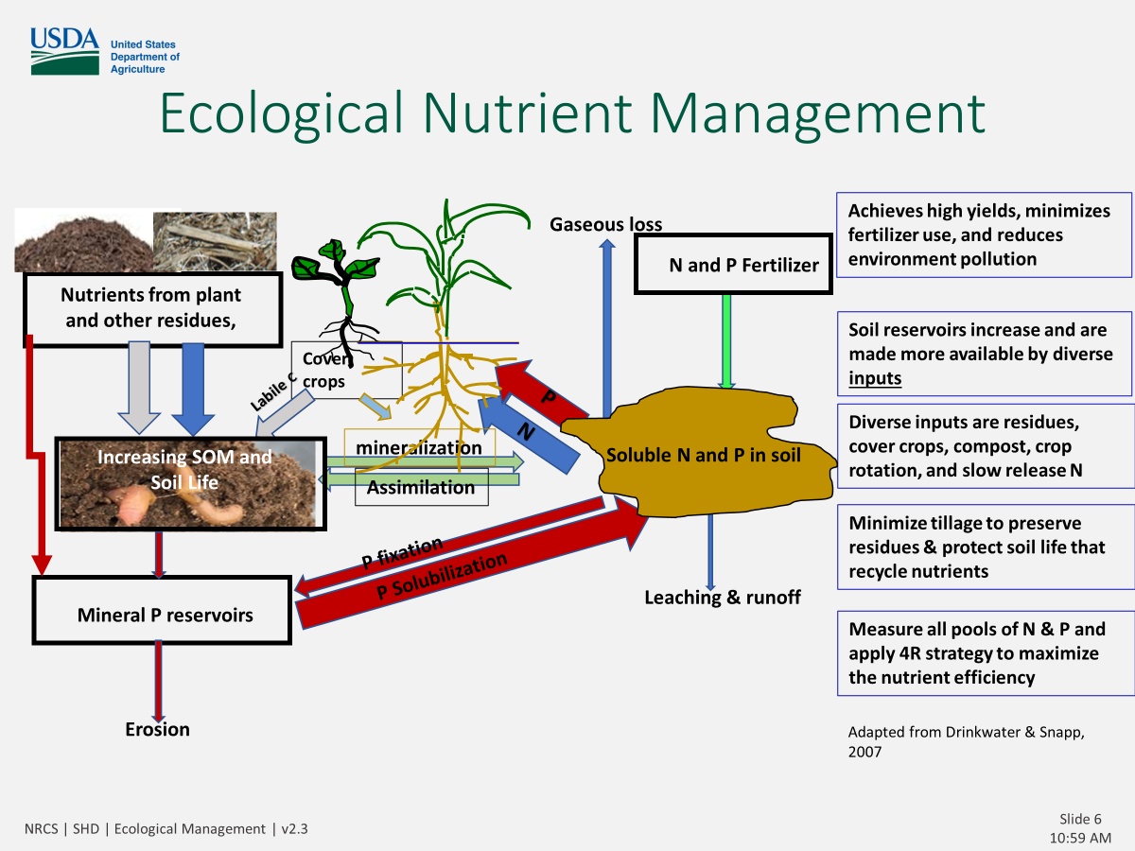
Only 30-55% of Inorganic Fertilizer is Directly Used by Plants
Fertilizer N applied (lb/ac) | Corn grain yield (Bu/ac) | Total N in corn plant (lb/ac) | Fertilizer-derived N in corn (lb/ac) | Soil-derived N in corn (lb/ac) | Fertilizer-derived N in corn as % of total N in corn
45 | 62 | 76 | 25 | 54 | 33
89 | 73 | 130 | 49 | 81 | 38
178 | 88 | 140 | 77 | 63 | 55
Calculated from Reddy and Reddy, 1993 and modified from Weil & Brady, The Nature and Properties of Soils, 15th ed.
Notes:
The majority of inorganic commercial fertilizers are utilized by the soil microbes before it is recycled to the plants. Fertilizer derived N only represents 33% to 55% of the N in a corn plant. Where does the rest of the N come from? The soil organic matter and the soil microbes. Most of the organic nitrogen becomes available later in the growing season as soil temperatures increase and rainfall occurs. So if we can increase our SOM and our soil microbial life, we can increase our soil nutrient efficiency. What about P? Source of Nitrogen in

Slide 23
New technology and integrated weed & pest management

Slide 24
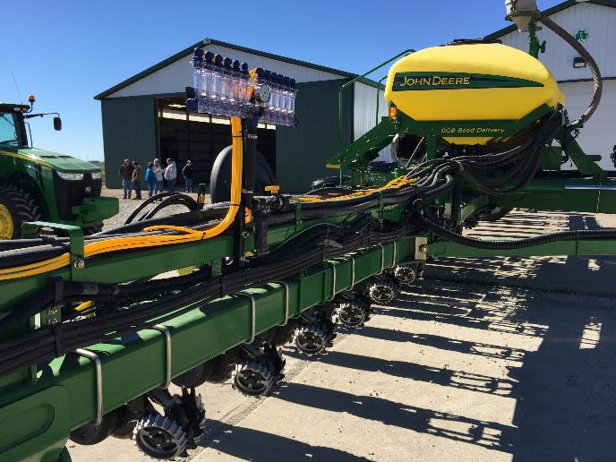
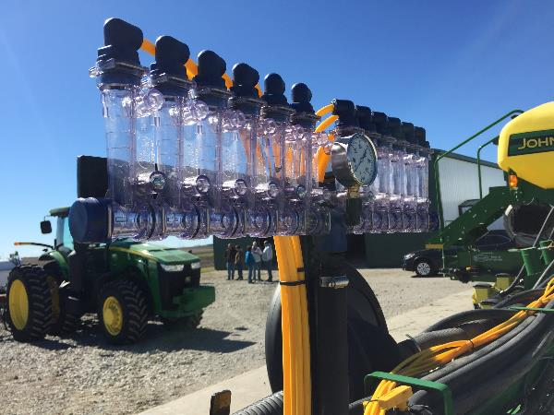
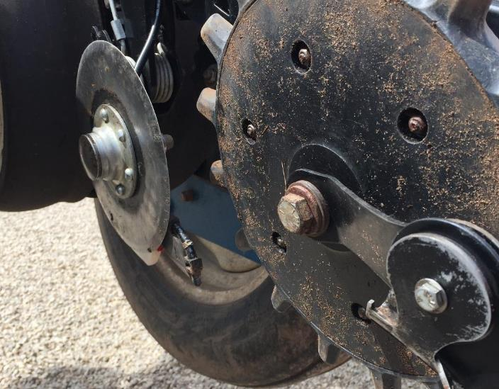
No-Till Planters
Precision nutrient placement and rate
With Adapted 4R Precision
Notes:
Examples planter attachments to improve fertilizer timing and placement for no-till
Have benefited from space age technology
Pictures show precision starter fertilizer placement

Slide 25
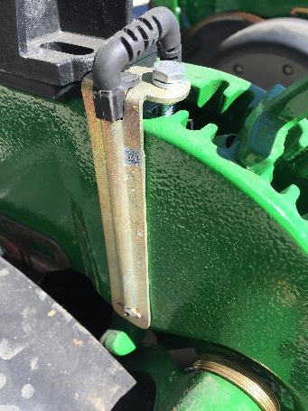
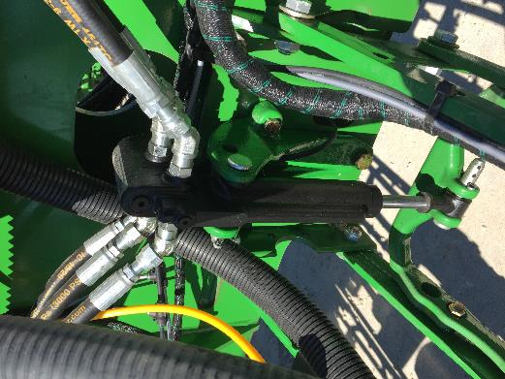
No-Till Planters
Sense and adapt to field conditions on the go!
With Space
Shuttle Tech
Precision downforce
in sub inch increments.
Notes:
Break this into 2 slide…1 for seed placement and one for starter
Examples planter attachments to improve seed and fertilizer placement
Have benefited from space age technology
Pictures show precision fertilizer placement

Slide 26
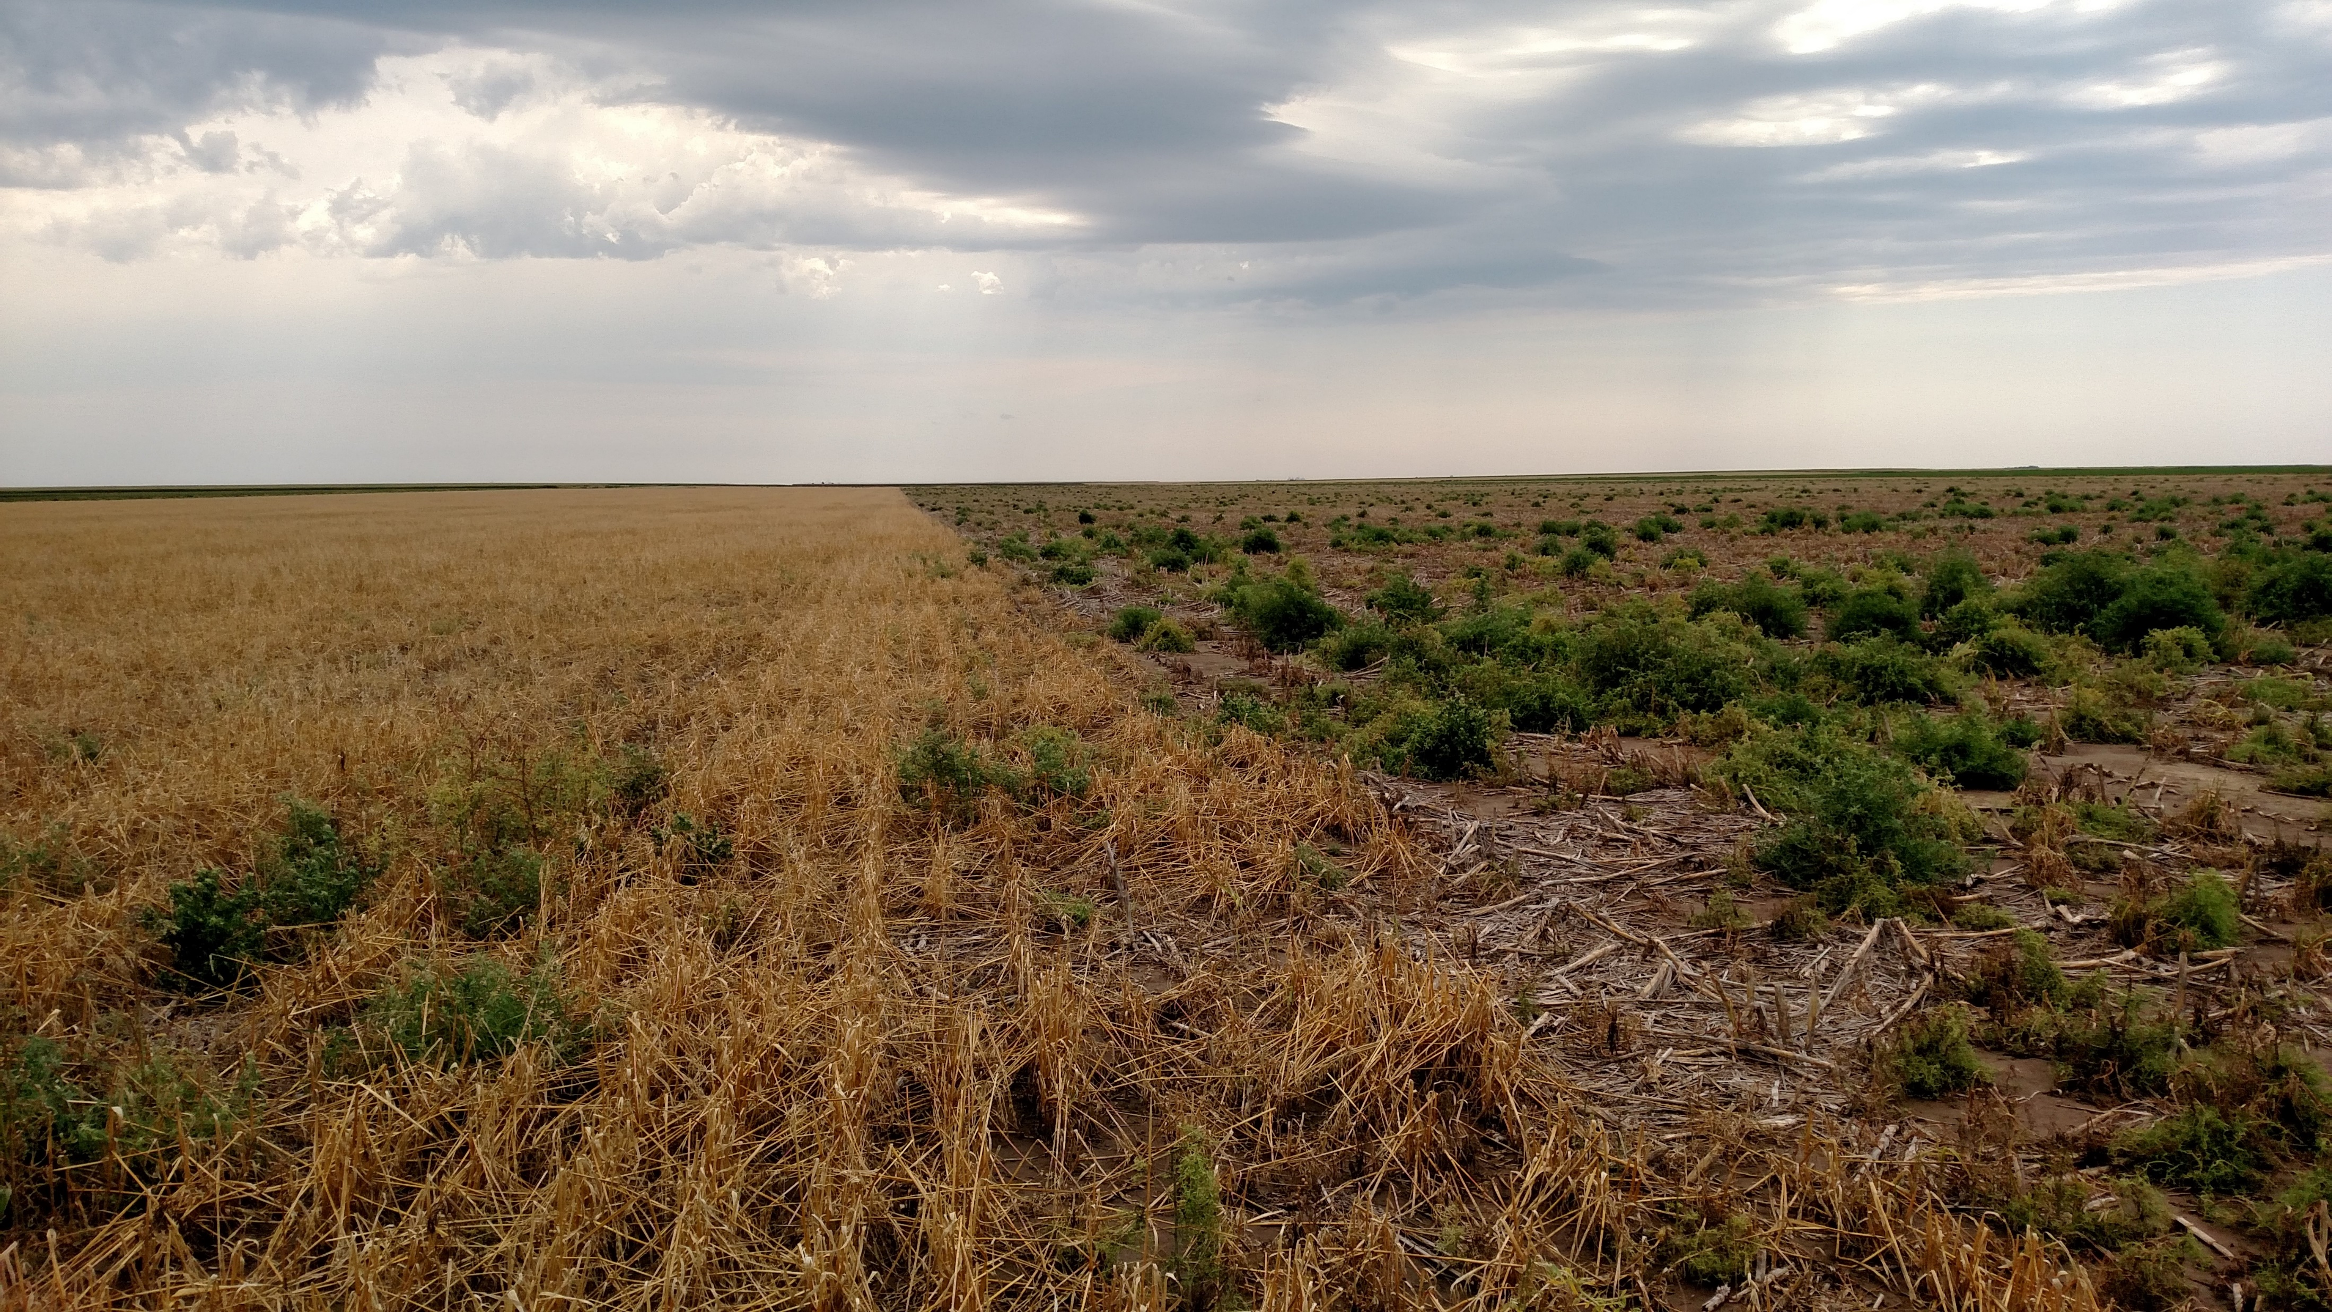
New Technology using Nature for Weed Management
Photo by: Larry Pridley with permission
Notes:
Here is an example of the effect of cereal rye cover crop used in place of the fallow part of the rotation vs. no cover crop and the impact of kochia during the fallow period. Use of cereal rye can cause an allelopathic effect on broadleaf plants in this scenario and can also increase competition due to increased biomass which doesn’t allow light to break dormancy and also moderates temperature.

Slide 27

Notes:
OPTIONAL SLIDE DEPENDS ON AUDIENCE EXPERIENCE

Slide 28
7 Strategies to Control Weeds with Cover Crops
Determine the time and emergence of target weeds.
Plan for robust growth of cover crops
Choose cover crop species that produce a significant amount of biomass
Choose species that meet your goals
Plan a strategy to allow allelopathy to work
Consider planting conditions and rates
Monitor the effectiveness
https://www.agriculture.com/crops/cover-crops/7-ways-cover-crops-help-fight-weeds
Notes:
See below for assistance for these 7 items
1. Determine the time of emergence of target weeds.
“Identify the weed species you want to control,” says Dille. "It’s important to get a cover crop well established before the target weed begins to emerge.
“Here in Kansas, summer annual weeds, like kochia, will come up very early in the spring – first of March in the western part of the state,” she points out. “Horseweed, a winter annual, begins to emerge in mid-September.”
2. Plan for robust growth of the cover crop.
To help the cover crop effectively compete with weeds, seed it well in advance of the time the problem weeds begin to emerge.
“Timeliness of planting the cover crop is critical to getting enough growth on the cover crops in order for them to be effective,” says DeAnn Presley, KSU soil scientist. “Cover crops should be planted six weeks before a hard freeze in order to produce enough biomass to outcompete weeds. Cover crops need a minimum of 6 inches of growth by the time weeds emerge.”
3. Choose cover crop species that produce a significant amount of biomass.
“Cereals are good choices for producing a lot of biomass,” says Dille. "These include cereal crops like triticale, oats, barley, wheat, and cereal rye.
“Because cereals tend to grow upright in narrow rows, you can increase the effectiveness of the canopy by planting a mix of species including brassicas, like daikon radish or turnip,” she says. “Including legumes like clover will add nitrogen as well as help thicken the density of the cover crop canopy.”
4,000
The pounds per acre of dry matter production from cover crops that may be required for weed suppression.
4. Choose cover crop species that meet your goals.
For starters, choose species whose growth habits most closely match the needed weed-control time.
“Oats won’t overwinter, but they do a nice job of controlling weeds if you plant early enough in the spring to outcompete spring-emerging weeds,” says Presley. “In Kansas, barley and cereal rye will overwinter and provide weed control in spring. In one of our on-farm experiments, the farmer chose winter wheat as a cover crop, and it did a great job competing with both fall- and spring-emerging weeds.”
Cover crops planted in midsummer like sorghum-sudan or the millets can tolerate late-summer heat and will minimize fall-emerging weeds. Barley and oats seeded in September will also suppress weeds emerging later in the fall.
End use of the cover crop, such as for grazing, also figures into the choice of cover crop species.
5. Plan a strategy for allelopathy to work.
When intending to take advantage of allelopathy as a weed-fighting mechanism, consider that allelopathy occurs most effectively as plant material is decomposing.
“Allelopathy occurs after allelopathic plants such as rye or the brassicas are killed and their plant material is breaking down,” says Dille. The chemicals being released from the decomposing plant material act like preemergent herbicides, reducing the likelihood that weed seeds will germinate.
Giving this process time to work after termination of the cover crop and before the planting of the subsequent crop requires planning. “It’s a short window of opportunity,” says Dille. “Plan to terminate the allelopathic cover crop two to three weeks ahead of planting the main crop.”
6. Consider planting conditions and seeding rates.
“When flying cover crop seed on over soybeans or corn, we’ve seen that the population of the resulting cover crop tends to be uneven,” says Presley.
Aerially applying the seed at a higher rate helps to even out the cover crop stand.
Apply seed at a higher rate, too, when seeding late. “When planting late, increasing the seeding rate helps to compensate for the fact that some of the seeds aren’t going to come up,” she says.
Drilling cover crop seed right after harvesting the previous crop tends to produce a uniform stand. “Drilling results in a thick stand but one that is not as tall as a stand resulting from aerial seeding,” says Presley.
7. Monitor the effectiveness of the cover crop.
“In our experience, cover crops won’t eliminate the need for herbicides,” she says. “The weeds that do grow are smaller and fewer in number, making them easier to control with herbicide applications.”
By monitoring weed populations, you can evaluate the effectiveness of the cover crops as control agents under your growing conditions. To count weeds and compare their populations from year to year, lay a 36-inch square of plastic tubing on the ground and count the weeds inside, Presley says.
“Cover crops have some good potential for helping to fight weeds, but scouting is going to be as essential as ever,” she adds.

Slide 29
Adapted nutrient management
We can package a system of practices that Improve Soil Health!
Prescribed cover crops
Diverse crop rotation
Notes:
Prescribed Cover Crops
Discuss what this means, provide examples as to how cover crops can be “benefit the crop that follows”
Need to cover crop with a purpose…. Which will affected the selection of cover crop species that are used
Cover crops will be discussed in more detail in Module 7, so you don’t need to go into as much depth, walk through the example related to a corn bean rotation

Slide 30
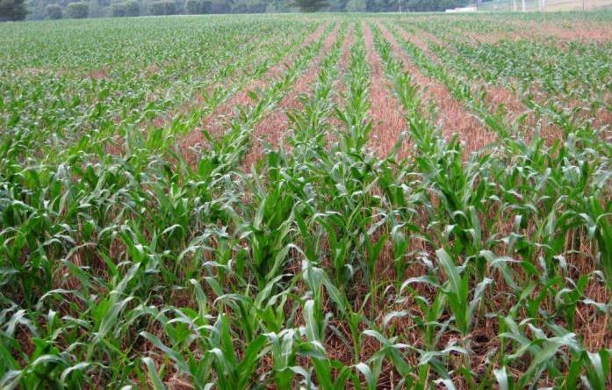
Strategically…CC Should Complement the Following Crop

Slide 31

Mineralization Vs. Immobilization
Mineralization:
Organic N +
Immobilization is the reverse of mineralization.
NH4/NO3
NH4/NO3 +
Organic N
Johnson et al. 2005, Cornell University
Notes:
Mineralization is a process by which microbes decompose organic N from manure, compost, residues, etc, to NH4 to NO3. and the rates of mineralization vary with soil temperature, moisture and the amount of oxygen in the soil (aeration).
All living things require N; therefore, microorganisms in the soil compete with crops for N. Immobilization refers to the process in which nitrate and ammonium are taken up by soil organisms and therefore become unavailable to crops.
Mineralization is the process by which microbes decompose organic N from manure, organic matter and crop residues to ammonium. Because it is a
biological process, rates of mineralization vary with soil temperature, moisture and the amount of oxygen in the soil (aeration).
Immobilization is the reverse of mineralization. All living things require N; therefore microorganisms in the soil compete with crops for N. Immobilization refers to the process in which nitrate and ammonium are taken up by soil organisms and therefore become unavailable to crops.

Slide 32
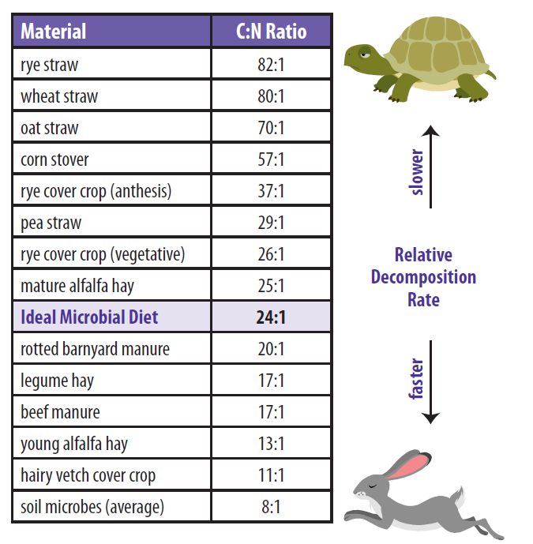
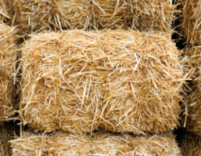
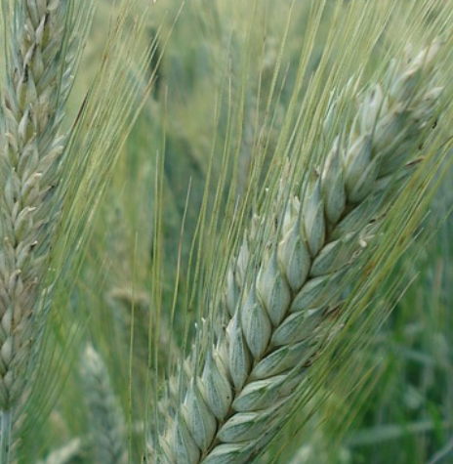
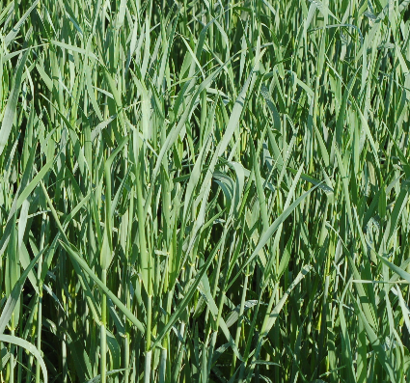
Strategically…CC should match desired C:N Ratio
Good for Soybean
Good for Corn
Notes:
Understanding plant species growth stage and relationship to Carbon:Nitrogen is key to overall strategies SEE HANDOUT C:N RATIO NRCS
Review chart and discuss various situations. Notice that Rye has varying C:N ration depending on when it is terminated.
Low C:N ration plants breakdown quickly, discuss the advantages and disadvantages of this,
See resources for C:N mgt for cropping systems for additional guidance

Slide 33
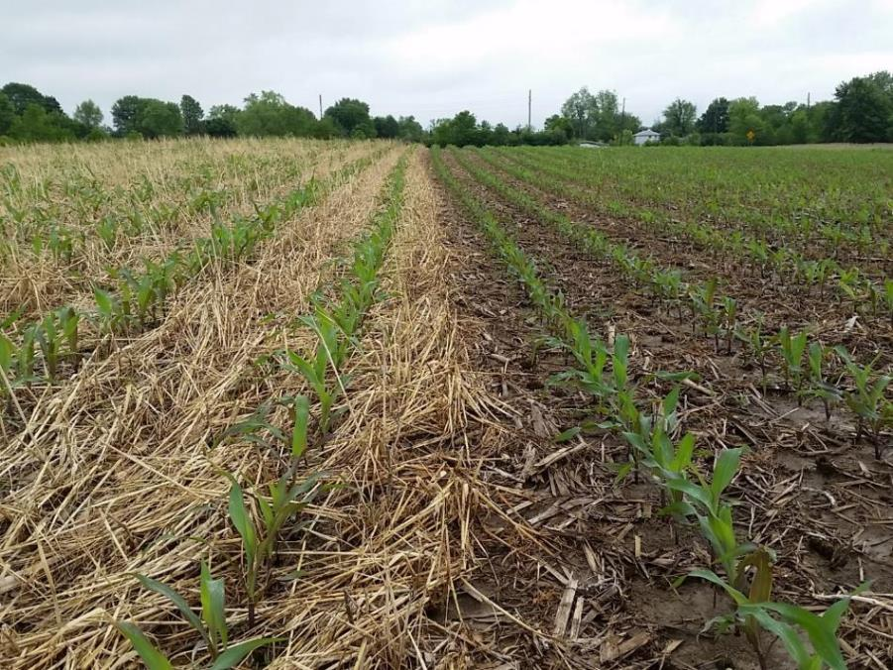
Strategically…CC should complement the following crop …Which is better?
Nitrogen Dependent Crops into:
High Carbon (Cereals Rye/Wheat)
…or
High Nitrogen (Protein)
Cover Crop (Clover/Peas)
Notes:
Pre-high nitrogen demanding crops (ie. Tomatoes, cereals, corn) crops should trap N in the fall, but release N at the optimum time in the spring. This corn into a cereal rye/Austrian winter pea/Crimson Clover mix
Predecessor is releasing the N at time of greatest need. Terminate the cereal CCs at boot stage or earlier to reduce N tie-up.

Slide 34
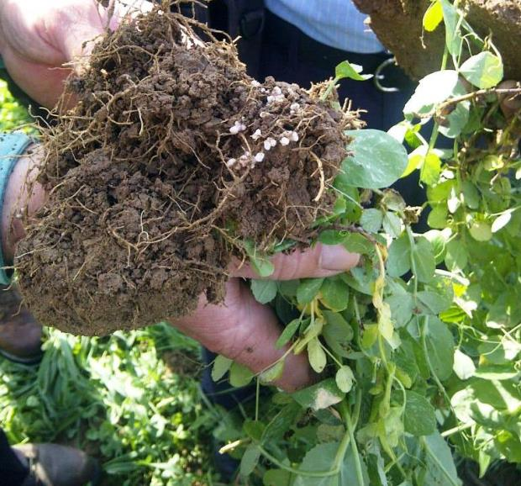
Strategically…CC Should Complement the Following Crop
Corn into:
High N (Protein)
Cover Crop (Clover/Peas)
Contributes high quality N
Less likely to harbor disease pathogens
Notes:
Fixing N requires a balance between allowing enough growth and still terminating at the optimum time in the spring. Legumes like Austrian winter pea or Crimson Clover will add nodules rapidly once the soil warms so delaying termination even a couple weeks could be a noticeable gain in organic N which will be more of a timed release at time of greatest need.
To Raise N (Protein%)
Select forage type grasses
Add Clover/Peas if…
Terminate Grass early when protein is high
…and consider adding:
Oilseed Radish, Rapeseed if…
CORN after corn strategy: Lower seeding rate for Cereal Rye are ahead of corn helps to reduce the potential for immobilization to occur. This corn into a cereal rye/Austrian winter pea/Crimson Clover mix is releasing the N at time of greatest need.

Slide 35
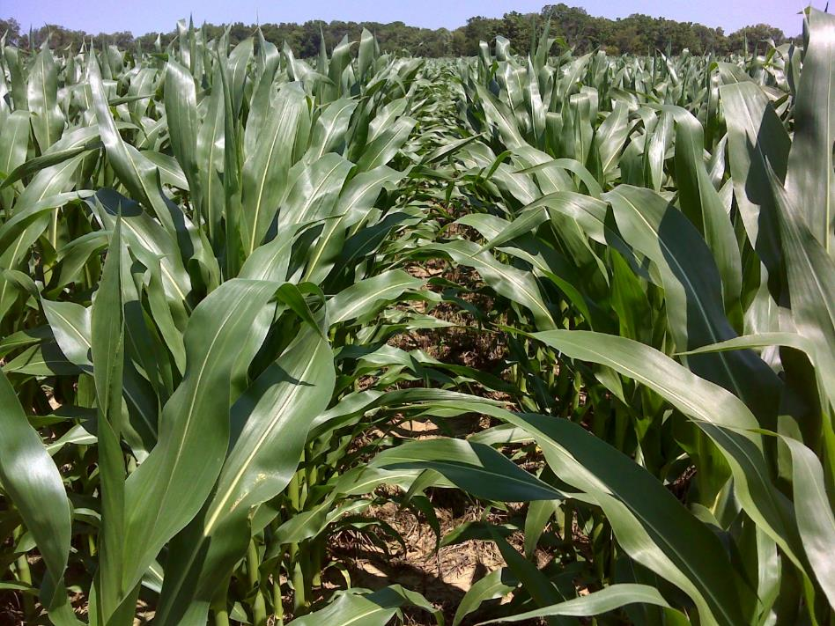
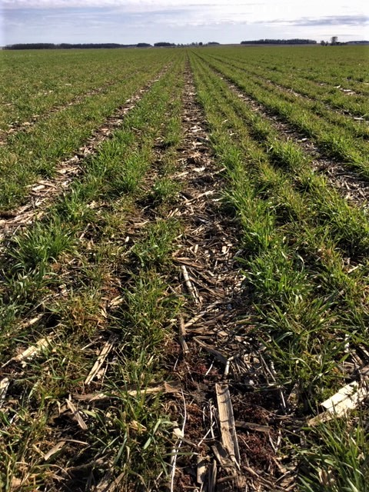
Strategically…
CC should complement the following crop
Corn strategy:
Strip Till
Easy spring management
Other innovations
Biotill
Notes:
Animated slide-Other strategies merely provide more distance in the soil between young corn roots and high carbon CC roots. Biotill: planter box with brassicas you plant in the brassica row

Slide 36
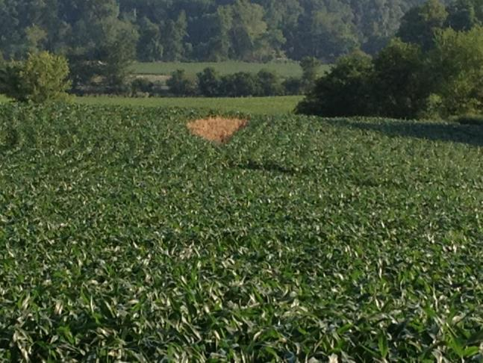
Strategically…CC Should Complement the Following Crop
Corn into a mix:
High Protein
Can Provide:
  Optimum Nutrient Release
  Extra water During rapid demand
Notes:
N seem to be releasing timely with major uptake after cover crops break down

Slide 37
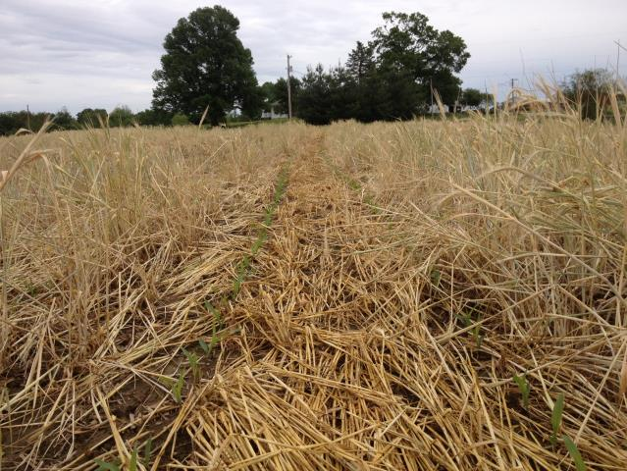
Strategically…CC Should Complement the Following Crop
Corn into a mix:
High Carbon (Rye)
Provides erosion and weed control
Uses/ immobilizes:
  Nitrogen/ nutrients
  Disease?
  Starter N a must!
Notes:
Negative; TIE UP however even with some cereal rye in the mix, N seem to be releasing timely with major uptake

Slide 38


Strategically…What about Legume or low N Dependent Crops?
Choices
Do Soybeans need N ?
…Sure, but they capture their own!
Notes:
Soybeans are not adversely affected by immobilized N…in fact they seem to respond favorably as shown by these beans into a cereal rye/forage brassica CC mix. As legume soybeans will produce more N if it is not available in the soil.

Slide 39


Strategically…
Legumes do well into a high carbon Cover Crop.
…Why?
Weed Control, Late Season Water and Nutrient Cycling
Notes:
Soybeans seem to respond favorably to-
early season weed control
late Season Water
Increased nutrient Cycling
From cover crops as shown by these group 2.8 beans.

Slide 40
Starting the System
Example of a Corn and Soybean System being strategically planned over 18 months
Notes:
You may add your own slides for your local system from 41 to 50. Please adjust if this does not work Use an easel or even word on the screen and type up a system in your area, id the gaps between the crops, strategically design a cover crop mix, and consider the way the system will be set up ecologically I.e. change in nutrient, pest, disease, water use etc.)

Slide 41
Starting the System
Here you can work in a group to develop a strategy see notes below
Notes:
Work in your local area question the audience about different crop rotations, what is planted when, cover crops that might fit, nutrient needs for the following crop, any instances of pest or disease that could be part of the system and how to avoid. This can be done on an easel with markers.

Slide 42

Strategically…Planning the System Using the Step-by-Step Approach
Drill or Aerial Seed Cereal Rye or Annual Ryegrass into Corn Stalks
Notes:
So if we are planning a NT Corn- Soybean system with cover crops how do we start?
Spreading all the residue equally across the field, along with that familiarize yourself with the capabilities or limitations of the current equipment and what may need to be removed altered or bought.
NT Rye into corn stalks, It’s easy to establish and easy to kill. SB don’t require the N that corn does
NT a relatively early group soybean into the rye and try to plant these beans early in the planting season…this gives you a wider window to seed a cover crop mix next fall.

Slide 43


Strategically…Planning the System
2. Terminate the Cereal Rye at 12”…
Or…
Notes:
... 2. NT a relatively early group (2.6-2.9 depending on your region) soybean into the rye and try to plant these beans early in the planting season…this gives you a wider window to drill or plant a cover crop mix next fall. Farmers new to the system will want to plan to terminate at a vegetative stage or low carbon to nitrogen ratio, but if weather doesn’t permit, then success is still very manageable.
The picture on the left illustrates the low C:N ratio or vegetative stage terminated, the right show a stand that could have gotten away from the producer this can happen over a week , think of strategies how to mange this right hand picture. What are your options? Ask the class.
Answers possible: plant into it, mow it down (extra expense), burn it if culturally acceptable, harvest it
If they harvest it what can be done after? Plant warm season cover crops

Slide 44


Strategically…Planning the system
  3. Plant a short season Soybean into the Rye (preferably early in the season)
Notes:
2. cont. … Remember-It’s early- Scout often and bump your rate up a bit. Earlier soybeans are more determinant and don’t branch as much

Slide 45




Strategically…Planning the system
4. Plant a low C:N mix into or after Soybean
Notes:
3. plant a low C:N mix after SB. If you are new to the system, something that winterkills like Oats and daikon radish, may be a good first combination or oat crimson clover and mustards etc. For higher soil health and water quality benefits- try a mix of oats and daikon radish with cereal rye, forage rape, crimson clover and winter peas. In many cases the oats and radish emerge and grow quickly in the fall and provide some winter protection to help peas and clover survive the winter. They then winter kill leaving a more open CC canopy that will still hold nutrients but will be easier to plant into and manage. IF Cereal Rye is planted the percentage of the grass portion should be low. The entire mix could be reduced in plants per square foot as well to help reduce competition for nitrogen and water.

Slide 46

Strategically… Planning the system
18 months into the system we have had:
Three no-till plantings (Minimized Disturbance)
Year-round ground cover (Maximized Ground Cover)
Added diversity that was lacking (Maximized Diversity)
Two winters of a living root (Maximized Living Roots)
Notes:
Two winters of a living root means that we added diversity to the system that was lacking before we added a cool season grass and cool season broadleaf that was lacking we have all four different functional groups in the system now.

Slide 47


Strategically…Planning the system
5. NT Corn into a: Biologically active high functioning soil
Notes:
4. NT corn into the low C:N mix the following spring. This makes the NT corn actually the 4th NT operation that has the advantage of a soil that already has many of the healthy qualities we expect from a more mature system. Nutrients will be more readily available to the corn crop due to the low carbon content of the cover crop.
The first picture is just after emergence, second picture is 4 weeks later you can see the stover turning over.

Slide 48
Options for Higher Level Management

Slide 49


Strategically…Planning the system… for a higher level?
6. Add a Small Grain and make it a true rotation
A Small Grain gives
endless options…
Notes:
If we want to take the system to an even higher level then extending the rotation to open more windows for diversity is a next logical step.

Slide 50

Strategically…Planning the system… for a higher level?
7. Maximize Diversity by companion cropping…
Notes:
Maybe look into companion cropping

Slide 51


Strategically…Planning the system… for a higher level?
8. Maximize Diversity by adding livestock…with high end grazing systems
Notes:
And where practical, integration of livestock that are managed under a prescribed grazing system can have a major benefit.

Slide 52


Strategically… Planning the system
9. Enjoy The Rewards of Soil Health!
Notes:
…By using sound logic and planning a mix with a optimal C:N ratio for the rotation, N release is more timely, as shown in the example above- then the corn crop that benefits from the time released nitrogen.
Result… Enjoy Great production potential. With this step in approach soil functions and aggregate stability from the extra biology greatly reduces the odds of a yield drag…if fact we may (likely) have an improved yield potential the first year we plant corn into this system!

Slide 53

Managing for a Living Ecosystem is Key to Optimum Production
Agronomic Efficiencies are Optimized When Soil Health is Maximized
“We can take production and conservation further with management systems that continually build Soil Health ”
Capture the potential!
Notes:
Soil Health Cropping Systems are good for the economy…environment….they are great for the very air we breathe …and best of all they are doable!
Time is now, if we are to capture the potential!

Slide 54

This information is provided as a public service and constitutes no endorsement by the United States Department of Agriculture or the Natural Resources Conservation Service of any service, supply, or equipment listed.
While an effort has been made to provide a complete and accurate listing of services, supplies, and equipment, omissions or other errors may occur and, therefore, other available sources of information should be consulted
The USDA is an equal opportunity provider and employer.
Meeh, NRCS

